Slide 1
PREDICTING MOVIE RATINGS
Nicholas amoscato, Julie de Lorenzo and chun ping ng

Slide 2
OVERVIEW

Slide 3

Why predict movie ratings?
Theoretically you could predict the success of an arbitrary movie prior to its production
You can prevent big failures at the box office and give the films with the most potential the best financing

Slide 4

Okay, money. Why else?
It also allows for a better understanding of what draws us in to a film or turns us away
We can identify the unifying features of the stories we connect to most

Slide 5
Related work: Augustine, Pathak, u. texas
Achal Augustine and Manas Pathak from U. Texas explored the relationship between a film’s quality and a subset of the individuals involved
Looking at 1100 movies from 1995-2006 they had a test error of 9.983 %

Slide 6
Related work : Armstrong, yoon CMU
Nick Armstrong and Kevin Yoon from CMU looked at the relationship between a movie’s average rating on IMDB and some of the film’s attributes
They used Sequential Forward Search to narrow the features and then applied the kernel regression and linear model tree models
They achieved 14.11 % (kernel regression) and 14.40 % (model tree) deviation from the true rating

Slide 7
Related work: Steven haar, s. Illinois u.
Haar also used IMDB data but limited it to feature-length films from the US, a subset of 44,000 films
He applied to this subset multivariate linear regression as well as artificial neural network
Neural network 42 % better than control, linear regression 38 %
Concluded that neural network was superior for this type of calculation because it wasn’t limited to a linear model

Slide 8
Our choice of models
Model Tree: can take nominal inputs (as many movie features are) and produce continuous output
Neural Network: able to extract complicated trends and patterns that escape human observation

Slide 9
approach
Preprocessing & Feature selection

Slide 10
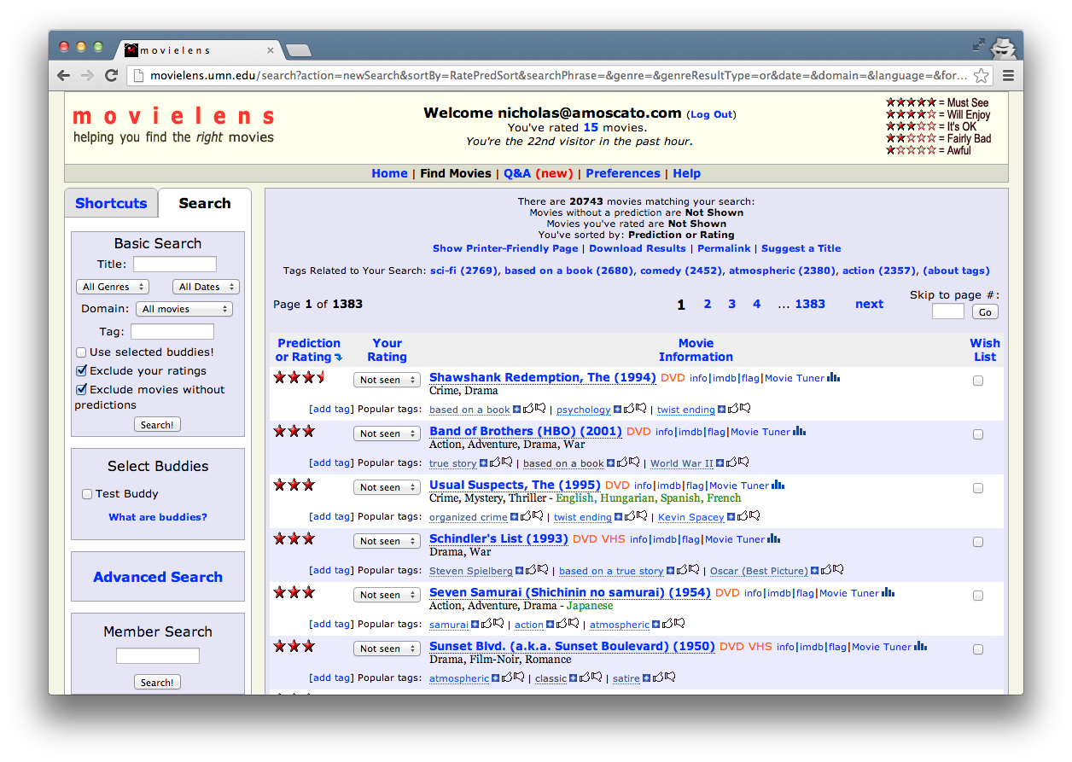

Slide 11
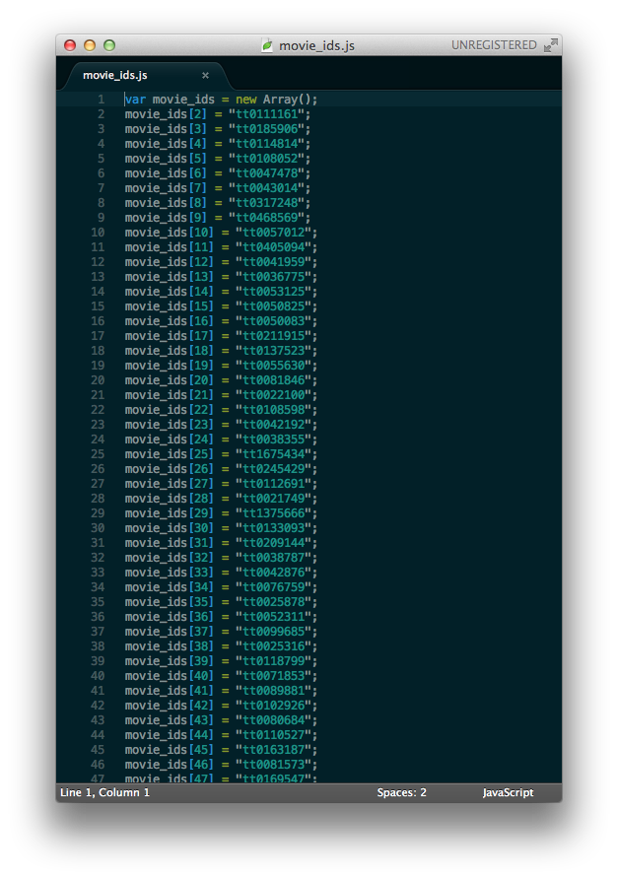
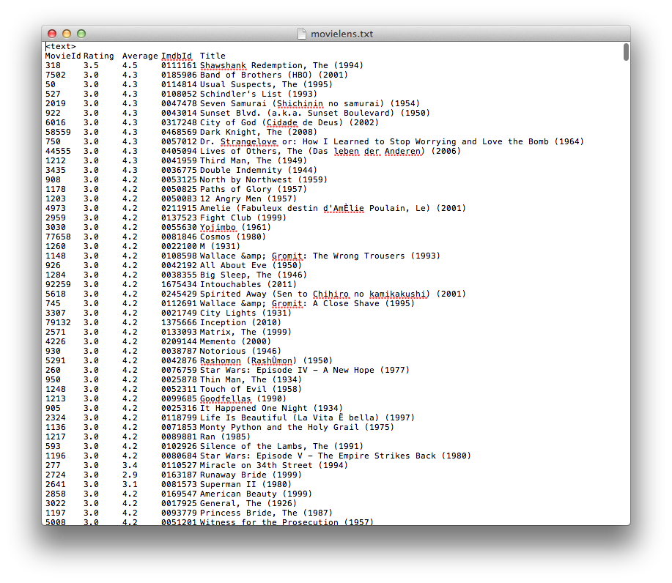

Slide 12


Slide 13



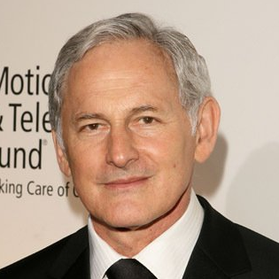
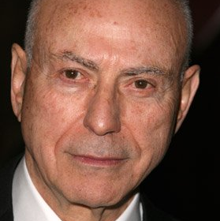
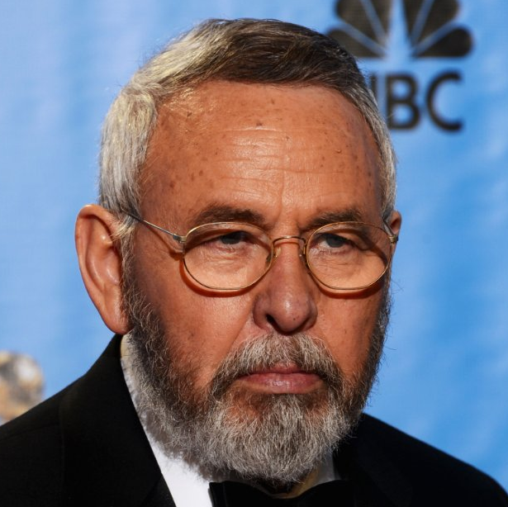

Cast Directors Writers Genres Language Country MPAA Rating Release Year Weekend Runtime
Drama, history, Thriller
English, Persian
USA
R
2012
YES
120 min

Slide 14
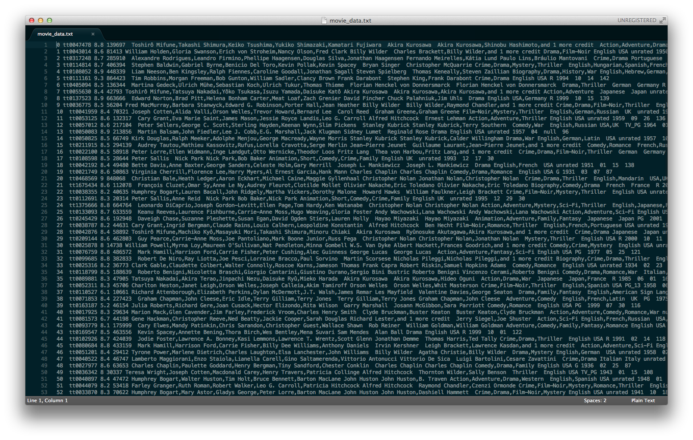


Slide 17
CLEAN DATA
REPLACED-MISSING DATA
11,889 Examples
17,240 Examples

Slide 18
Experiment SETUP
MODEL TREE & NEURAL NETWORK

Slide 19
Model Tree
adapted decision tree with
leaf node linear models

Slide 20
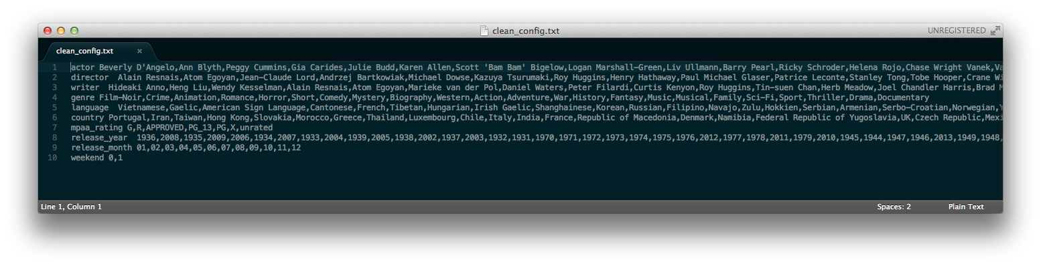
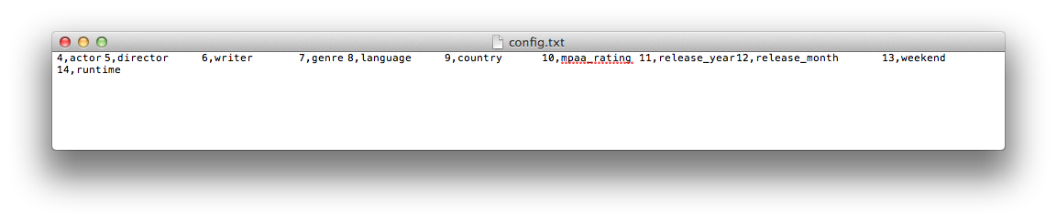
MODEL TREE CONFIGURATION

Slide 21
isWeekend
yes
no
MPAA
MPAA
G
…
R
…
Country
Genres
Director
Genres
Drama
Thriller
Horror
X
…
Y
…
Z

Slide 22
HIGH Cardinality
Lots and lots of actors

Slide 23
Actor 2
5 Actors
Actor 3
Actor 1

Slide 24
Artificial neural network

Slide 25
Actor, writer, director score
Cumulative actor score
Individual Actor score
IMDB rating
Unable to split all the nominal features into an N set of binary values
Score is weighted by the participant’s rank in the film (e.g. lead actor gets high weight)

Slide 26

Weka implementation
Momentum
Hidden layers, number of neurons
Learning rate

Slide 27
Results and interpretation

Slide 29
baseline
Average rating across the entire dataset
clean data
Average: 6.3869
RMS: 1.0452
Replaced-missing data
Average: 6.4241
Rms: 1.0813

Slide 30
Model tree
Clean data
RMS: 0.931
Min. subset size of 10
Min. deviation of 0.5
Replaced-missing data
Rms: 0.992
Min. subset size of 20
Min. deviation of 0.2

Slide 31
Neural network
Clean data
RMS: 0.98
Replaced-missing data
Rms: 1.088

Slide 32
Interpretation of neural network
Neural network seemed to choke on the nominal features in our dataset
Dividing them into binary values wasn’t feasible due to the computational complexity it created
The solutions we devised were probably not ideal and explain the relative weakness of the Neural Network result

Slide 33
At the end of the day…

Slide 34
Future work
What could we add?

Slide 35
If we continued this project…
Access IMDB directly: some papers were able to get at more features of the IMDB data than we were, and with larger subsets to boot. For example: isAdaptation, isSequel, type of color (e.g. Technicolor), budget, costume designer
Limit to Subset: one paper examined only feature-length films made in US. Could be more feasible to identify attributes that are successful contained to one area.
Model Tree: try different linear functions at the leaf nodes

Slide 36
The end!
Any questions for us?

